Slide 1

Presentation on Practical & Training Seminar
Internship Work Report
In
Submitted to:
Pooja Varshney
Assistant Professor, CEIT
Shyam Bihari Kumar
99695(A2)
Vth Sem , CEIT

Slide 2
Agenda
How I got the Internship
Internship Confirmation mail
About the Company
Introduction
About My Internship
Required Tools for this internship
Week First work
Week First Assignment
Week second work
Week Second assignment

Slide 3
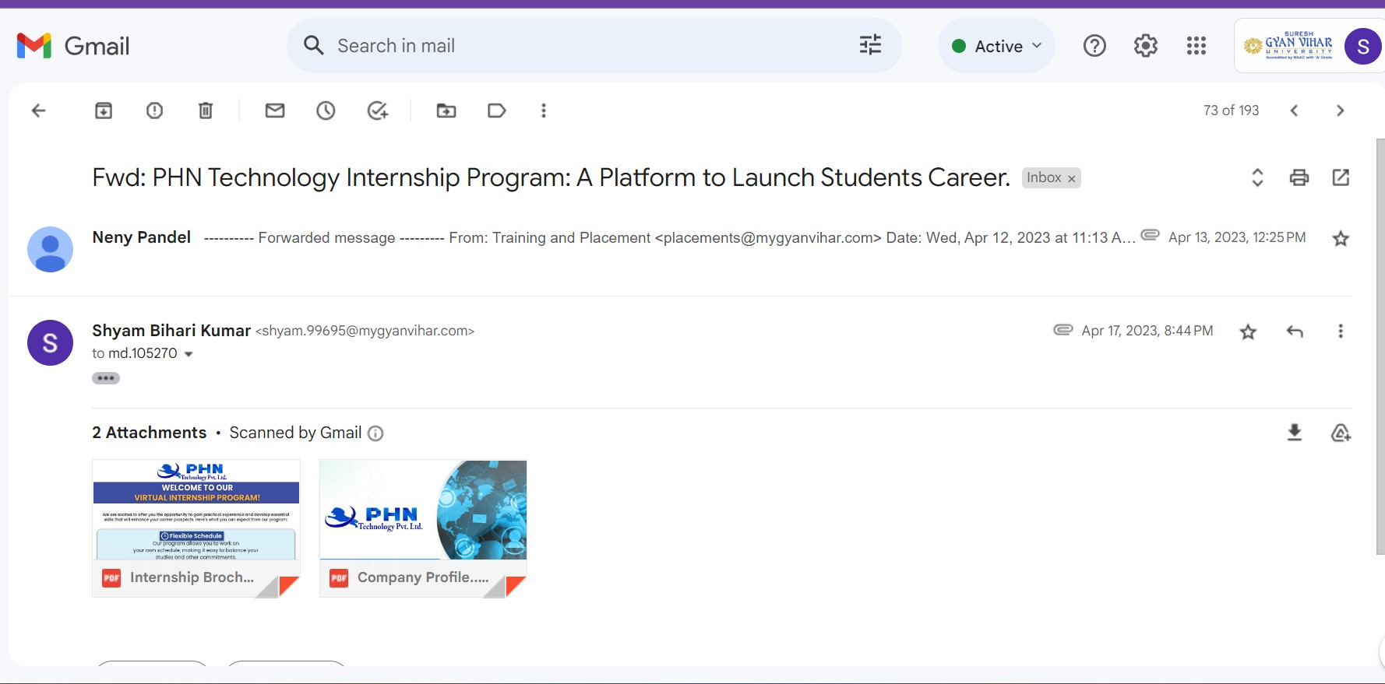
How I got the Internship
I got a E-mail about the internship program through the my department and then I apply for the Internship program and got to be a part of the company in the domain of Machine Learning and Data Science Using Python.

Slide 4
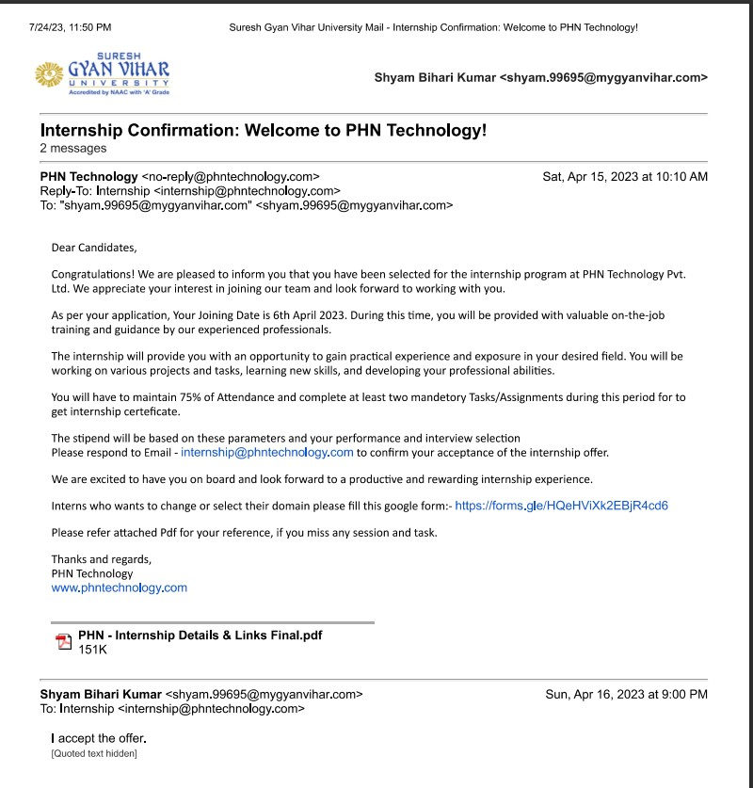
Internship Confirmation mail

Slide 5
In the internship offer letter, some condition was kept for the completion of the internship, which was written in the letter.
Maintain 75% attendance
Submit you task /assignment on time

Slide 6

About the Company
PHN Technology private limited is a Consultancy service based company which provide many software related service such as :
Business Solution
Robotics
Training & Education
Mobile App Development
Website Development

Slide 7
Introduction
An internship is a temporary work opportunity offered to students or recent graduates, providing practical experience in a particular field or industry. It allows individuals to apply their knowledge, develop skills,

Slide 8
About My Internship
I had selected machine learning and data science using python domain in my application form which I also received in conformation mail
Tenure: 2 months
Internship start date-06 April 2023
Stipend: Unpaid
My role in this internship –As a Intern
Mode: Work from home(WFH)

Slide 9
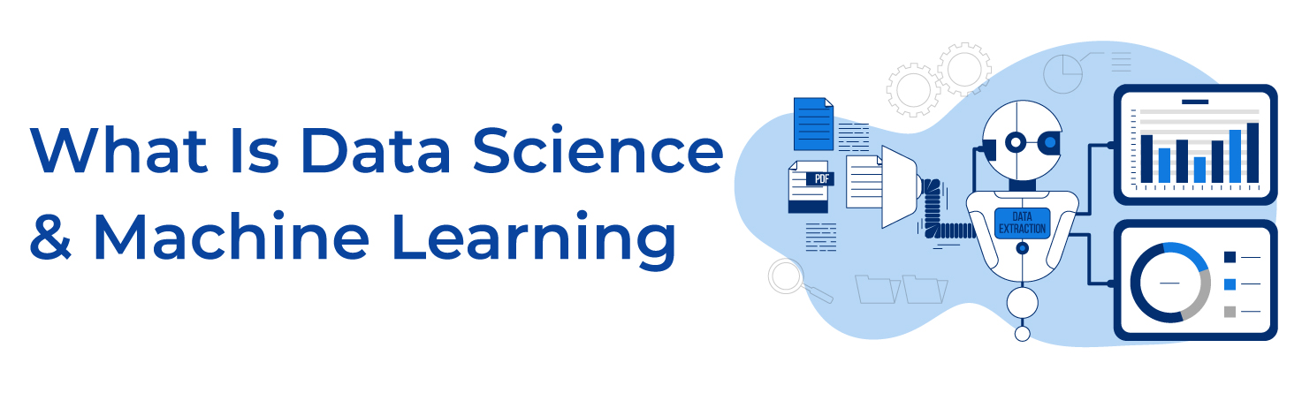
Data Science:
Data Science is field of combines statistical analysis, machine learning, and domain expertise to extract insights, make predictions, and solve complex problems using large volumes of data.

Slide 10

Machine Learning:
Machine learning is a field of artificial intelligence where computer systems are designed to learn from data and improve their performance without explicit programming.

Slide 11
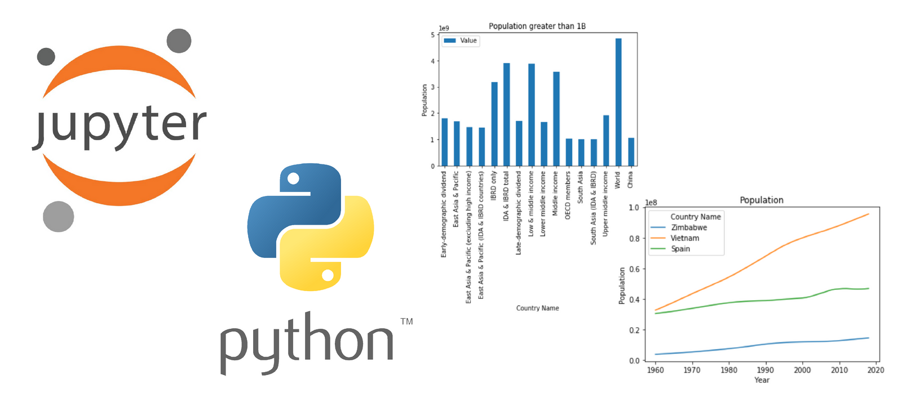
Required platform for this internship
Jupiter Notebook: It is an interactive computing environment that allows to create and share documents containing live code, equations, visualization and narrative text
Advantages:
Interactive Computing
Easy Data Visualization
Reproductivity
EDA
Library and Ecosystem
Cloud Integration

Slide 12
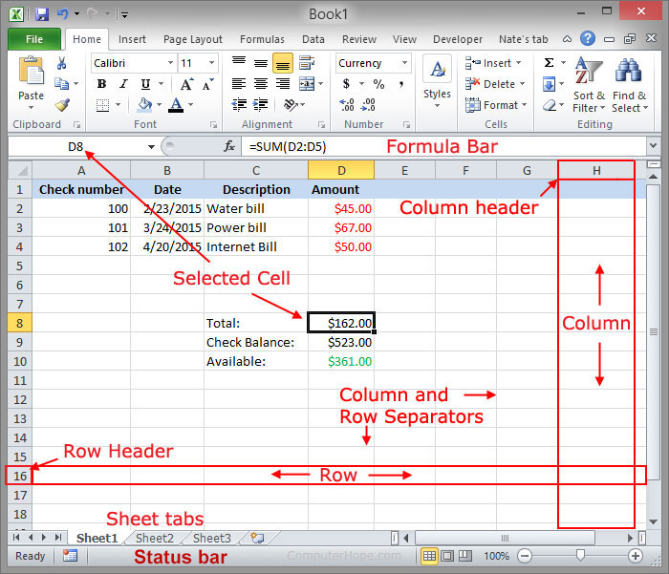
Excel:
Microsoft Excel is a widely-used spreadsheet application that has been a staple tool in various industries for decades.
Advantages of Excel in data science:
User-Friendly Interface
Data Manipulation
Formulas and Functions

Slide 13
Week First work
Here is what I learned in the first week of my internship
Why python programming?
Necessary items required for the programming in python?
What is data analytics ?
Libraries require for the data analytics

Slide 14
Why python programming?
It is easy to learn, has a large and active community, offers powerful libraries for data analysis and visualization, and has excellent machine-learning libraries.

Slide 15
Necessary items required for the programming in python?
Hardware — What you need and the difference between Desktops and Laptops
Software — Choose the Operating system that is right for you
Text Editors and IDEs
Online — Using online coding environments

Slide 16
What is data analytics?
Data analytics is the science of analyzing raw data to make conclusions about that information.
Libraries require for the data analytics
Pandas
NumPy
Matplotlib
Seaborn
Openpyxl
Scikit-learn

Slide 17
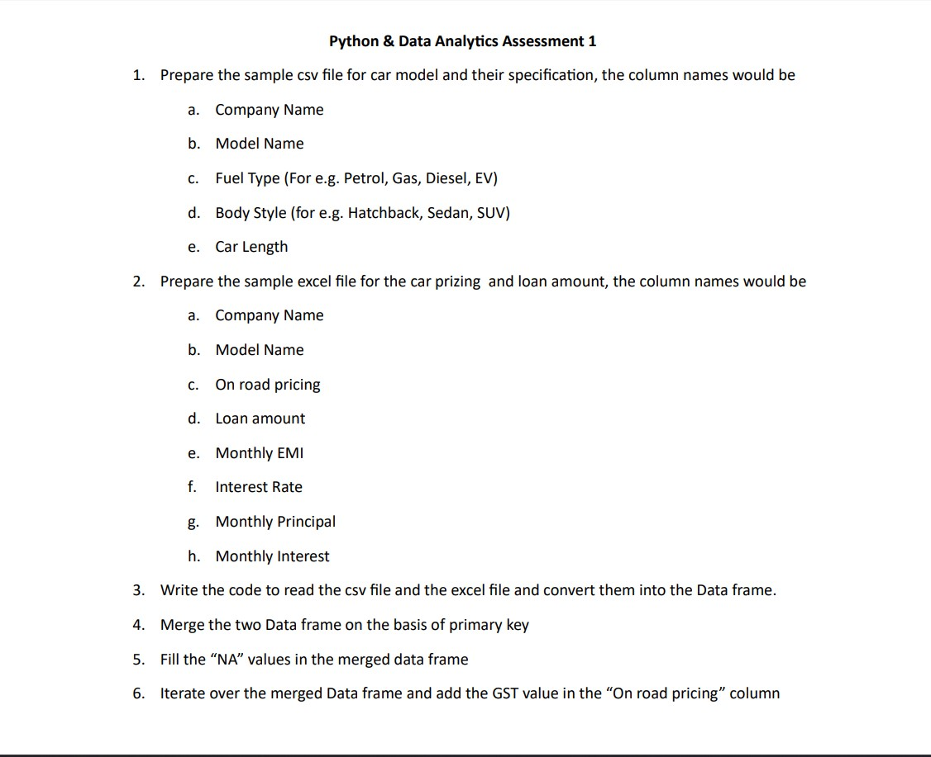
Week First Assignment

Slide 18
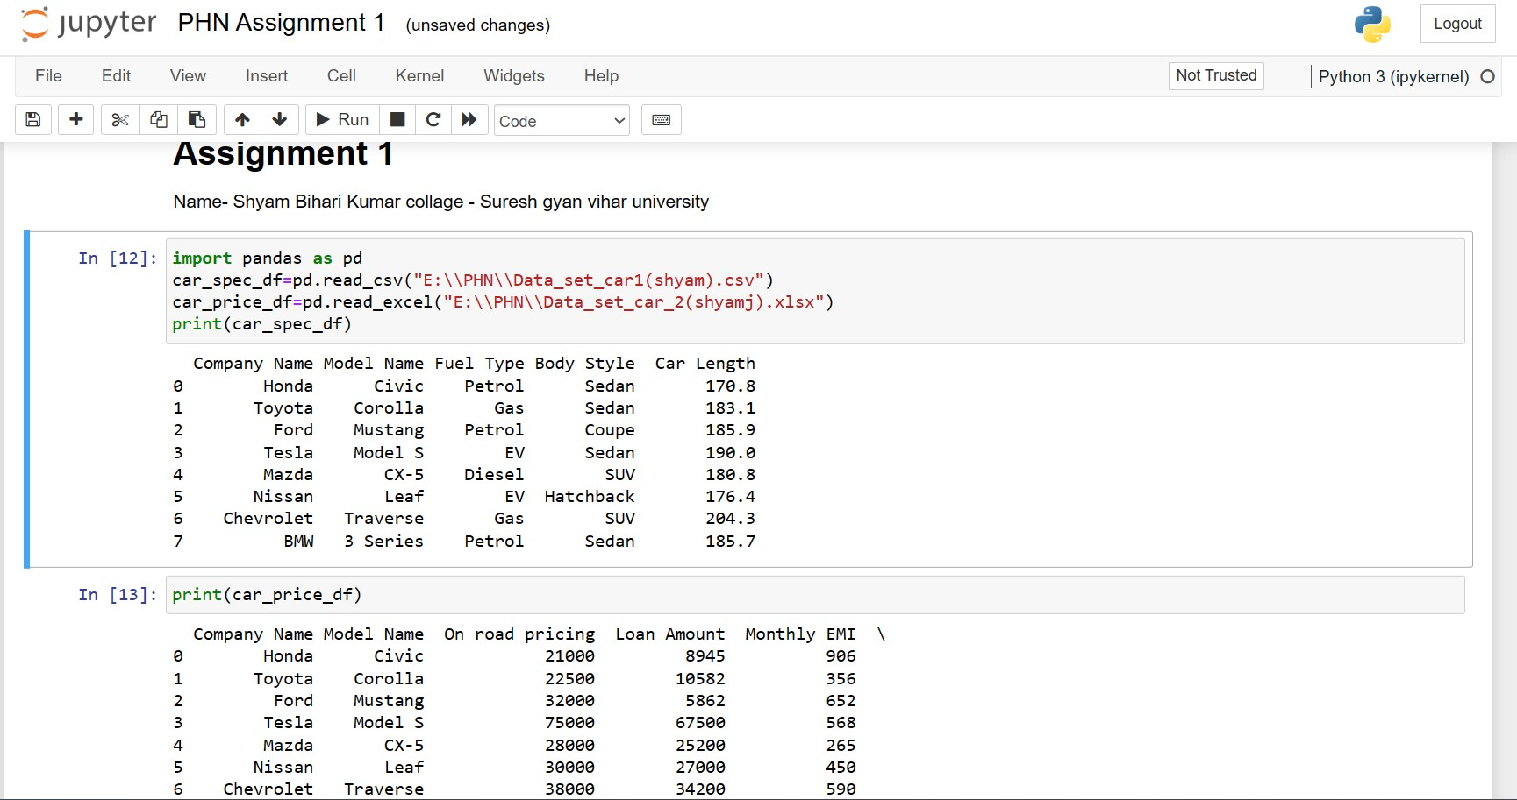

Slide 19
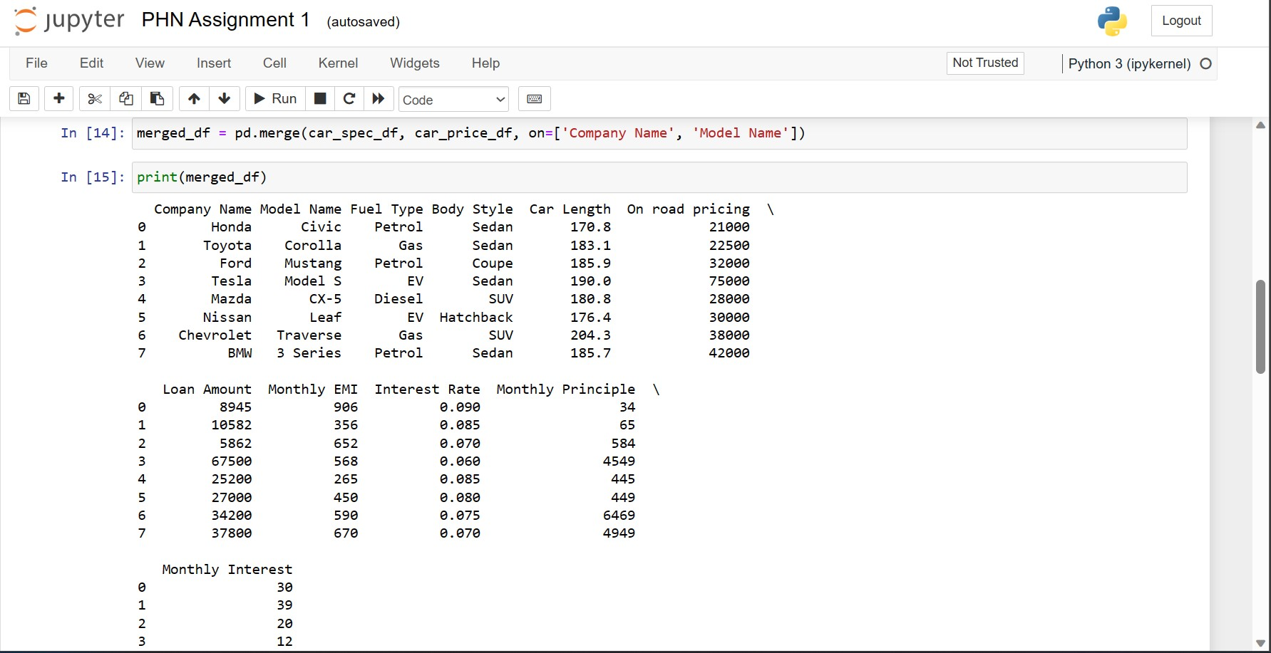

Slide 20
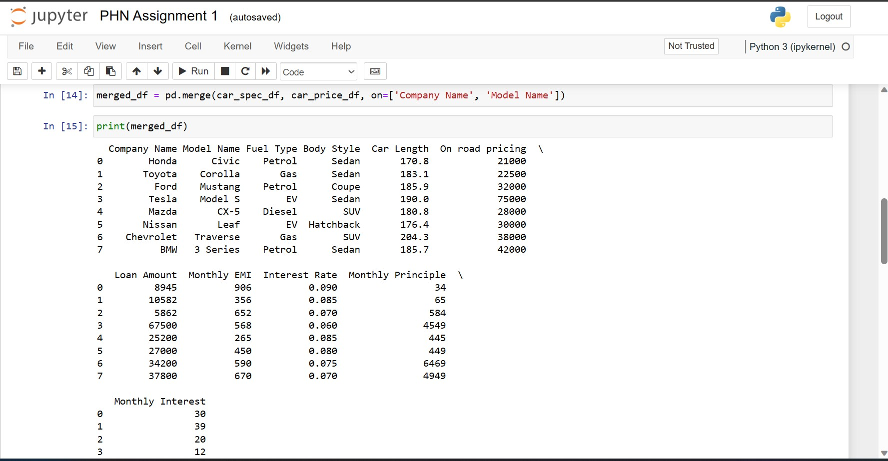

Slide 22
Week second
NumPy Library
Creating a NumPy Array
NumPy Methods
NumPy Universal Function
Indexing and slicing

Slide 23
NumPy-NumPy is a Python library used for working with arrays
Indexing and slicing-Slicing and indexing are two fundamental concepts in Python. They help you access specific elements in a sequence, such as a list, tuple or string.
NumPy Universal Function-A universal function is a function that operates on NdArrays in an

Slide 24
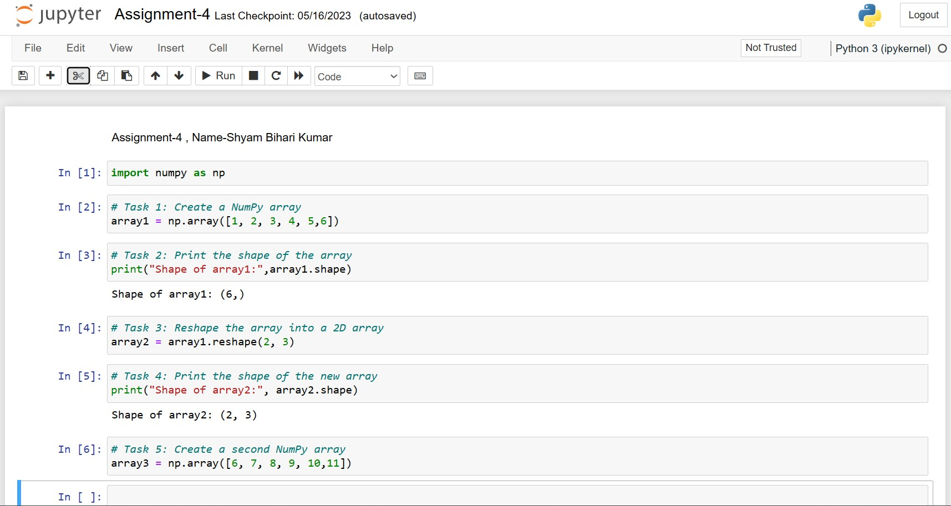

Slide 25


Slide 26


